Slide 1
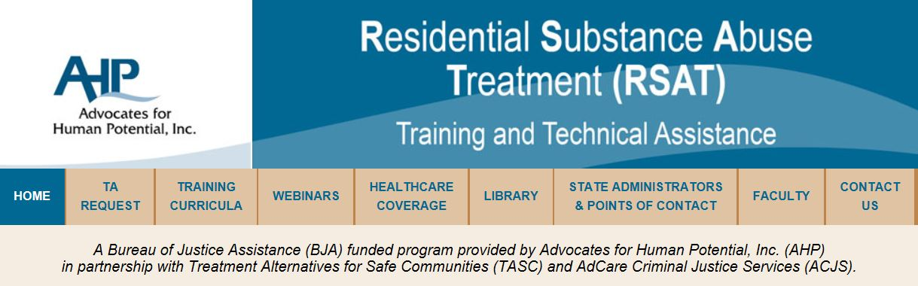
www.rsat-tta.com
Andrew Klein
Director, RSAT-TTA
Senior Criminal Justice Research Analyst
Advocates for Human Potential

Slide 2

Pennsylvania Department of Corrections

Slide 3

Missouri Department of Corrections

Slide 4

Massachusetts Department of Correction

Slide 5
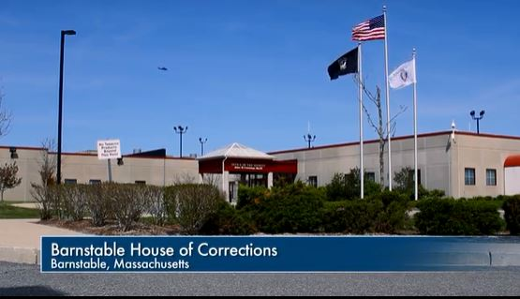
Barnstable, MA County Jail

Slide 6
Prison and Jail MAT Re-Entry Initiatives
COMMON ELEMENTS
Opioid &/or Alcohol Use Disorders
Complete in-house substance abuse treatment programs (6 months)
Informed about all FDA approved medications
Volunteer to participate
Enroll in Medicaid, health insurance exchanges, etc.
If choice is Naltrexone (Vivitrol™), non-narcotic that blocks euphoric effects of opioid/alcohol & reduces craving, following steps:
  medical examination (liver, drug test for 7 day abstinence, etc.)
  potential adverse effects explained
  oral Naltrexone dose test
  injection week to 2 days before release (28 days)

Slide 7
Post-Release
Warm hand off to counseling that also provides FDA approved medications (MA DOC: Inside/Outside “Navigators;” Sacramento “reentry specialists”)
Client may choose to remain on injected Naltrexone
or switch to other medication after consultation with physician/treatment provider
Remains in treatment/medication to avoid relapse
(six months to one year recommended)
While treatment may be mandated by parole/probation, medication is not

Slide 8
Common Challenges Establishing MAT in Prison/Jail
Getting buy-in and leadership from DOC/Behavior Health Agency
Getting prison/jail and community substance abuse programs to accept non-abstinence based treatment programming, inc. correctional officers
Getting buy in from inmates, their families
Getting contracted prison medical physicians to prescribe medications, educating them about medications
Getting enough community based treatment providers on-board so continued medication/counseling accessible to released inmates
across state
(Rural PA: Vivitrol Van makes monthly rounds)
Getting state Medicaid managed care plan and health insurance providers to include funding of medication without requiring prior treatment failures, etc.

Slide 9
Prison MAT Reentry Programs
Kentucky (reentry-two Vivitrol injections)
Massachusetts (Vivitrol reentry)
Missouri (Vivitrol reentry)
New Hampshire (Oral Naltrexone maintenance & Vivitrol reentry)
New York (Vivitrol reentry, Edgecombe prison, 45-day parole diversion program offenders and
a small number of female work release participants.
Pennsylvania (Vivitrol Re-entry and methadone/Suboxone maintenance)
Rhode Island (Vivitrol Re-entry and methadone/Suboxone maintenance)
Tennessee (reentry-two Vivitrol injections)
W. Virginia (Vivitrol reentry)
Wisconsin (Vivitrol reentry)
Federal Bureau of Prisons (field trial, reentry-2 Vivitrol injections)

Slide 10
Jail MAT Re-entry Programs
114 jail Re-entry Programs (in progress/announced)
California (3) Maryland (13) Utah (1)
Colorado (1) Michigan (4) Vermont (1)
Connecticut (1) Missouri (1) Wisconsin (9)
Florida (4) Mississippi (1) Wyoming (1)
Illinois (3) Montana (1)
Indiana (8) New York (14)
Kentucky (3) Ohio (21)
Massachusetts (11) Pennsylvania (13)

Slide 11
Prison and jail Methadone/Buprenorphine Programs
Jails (Methadone) State (Methadone)
Arizona (3) Connecticut
California (2) Vermont
Connecticut (2) Rhode Island ( & Suboxone)
District of Columbia (1)
Florida (1) Buprenorphine Programs
Illinois (1) New York Jail
Maryland (2) Vermont Prisons
New Mexico (1)
New York (3)
Pennsylvania (4)
Washington (1)

Slide 12
But do they work?
Uniformly very high rates of entrance into post release treatment, even where inmates are no longer under correctional supervision (83% Methadone, 78% Vivitrol)
Uniformly low re-incarceration rates within one to three
years (18%)
Half the recidivism rate of California state average,
cost avoidance $125 per day
Relapse and re-arrest rate after six shots in PA convinced
DOC officials to encourage one year of injections
Methadone/Suboxone in prison/jail require special
security measures

Slide 13
Relapse w/in 6 Months
Lee, J. et. al. (2016) Extended-Release Naltrexone to Prevent Opioid Relapse
in Criminal Justice Offenders, N.E. Journal of Medicine

Slide 14
Drug Courts & MAT
FY 2015, BJA required Drug Court applicants to demonstrate that MAT will be available if/as determined to be “medically necessary.”
As of April 2015:
Drug Courts in 17 states reported using MAT, including Suboxone, Vivitrol, Oral Naltrexone, & Methadone. Some allow defendants to enter drug court with MAT but will then detox in consultation with the MAT provider.
*BJA Drug Court TA/Clearinghouse Project, American University, revised April 23, 2015

Slide 15
Special Issued Noted by Drug Courts
misuse and diversion of the medication
cost, particularly for Vivitrol
need to educate all stakeholders on the role of MAT in a drug court’s available resources;
need to disseminate relevant research on MAT and its import as an adjunct to SUD treatment;
need to build relationships with the medical community, particularly physicians specializing in addiction medicine;
need to have appropriate administrative protocols in place..

Slide 16
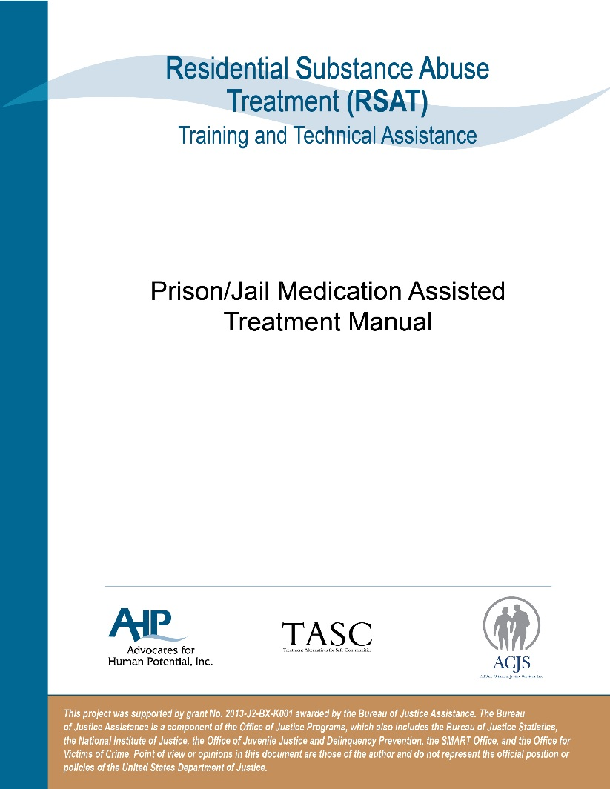
www.rsat-tta.com

Slide 17
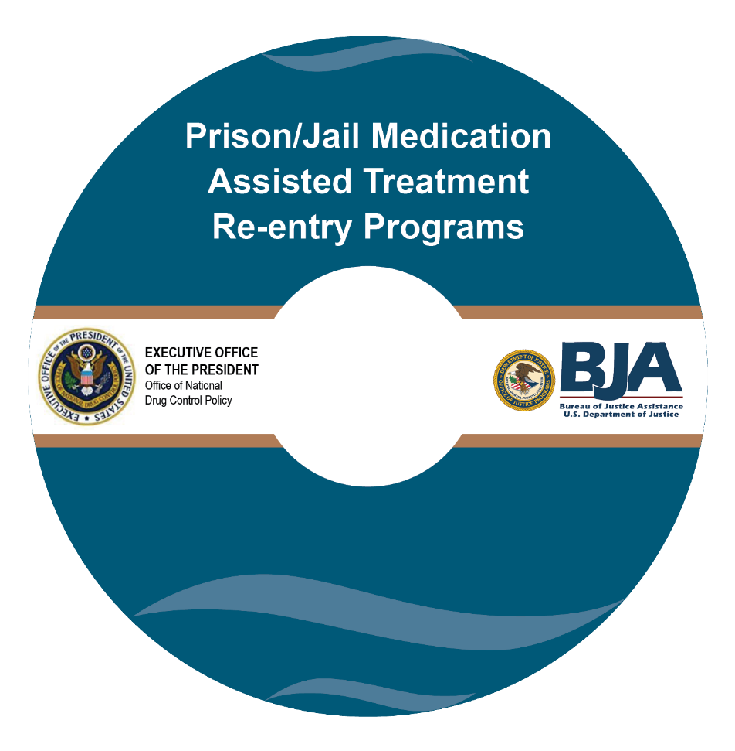
Prison/Jail MAT Re-entry Training Video aklein@ahpnet.com for TTA requests

